Slide 1
Jakob’s Law

Slide 2
“Users spend most of their time on other sites.
This means that users prefer your site to work the same way as all the other sites they already know.”
Dr. Jakob Nielsen

Slide 3

Analogue: automobile.
The need for a common “language” is present in web design. example
Will a badly designed site physically hurt anyone?
Don’t copy-paste but also don’t reinvent the wheel!

Slide 4
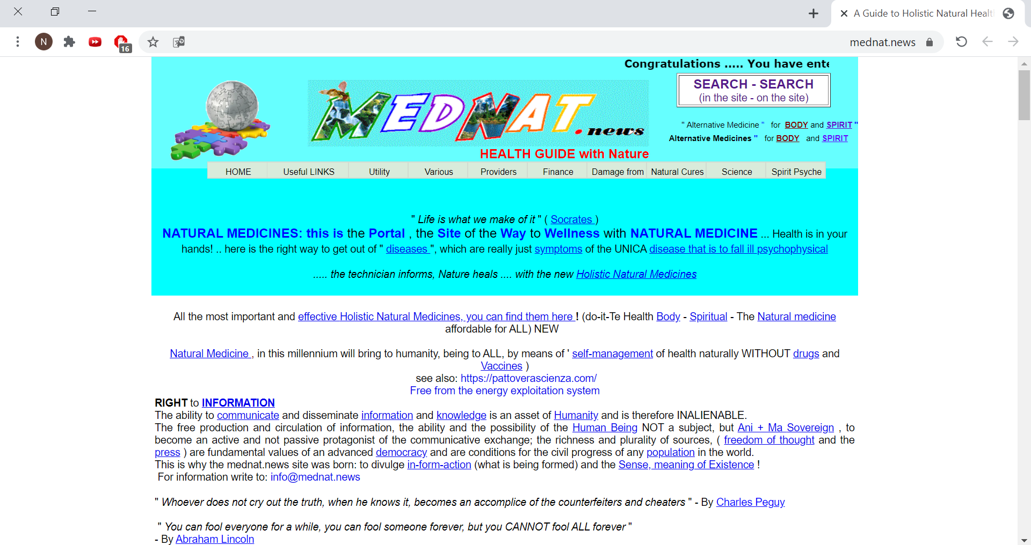

Slide 5
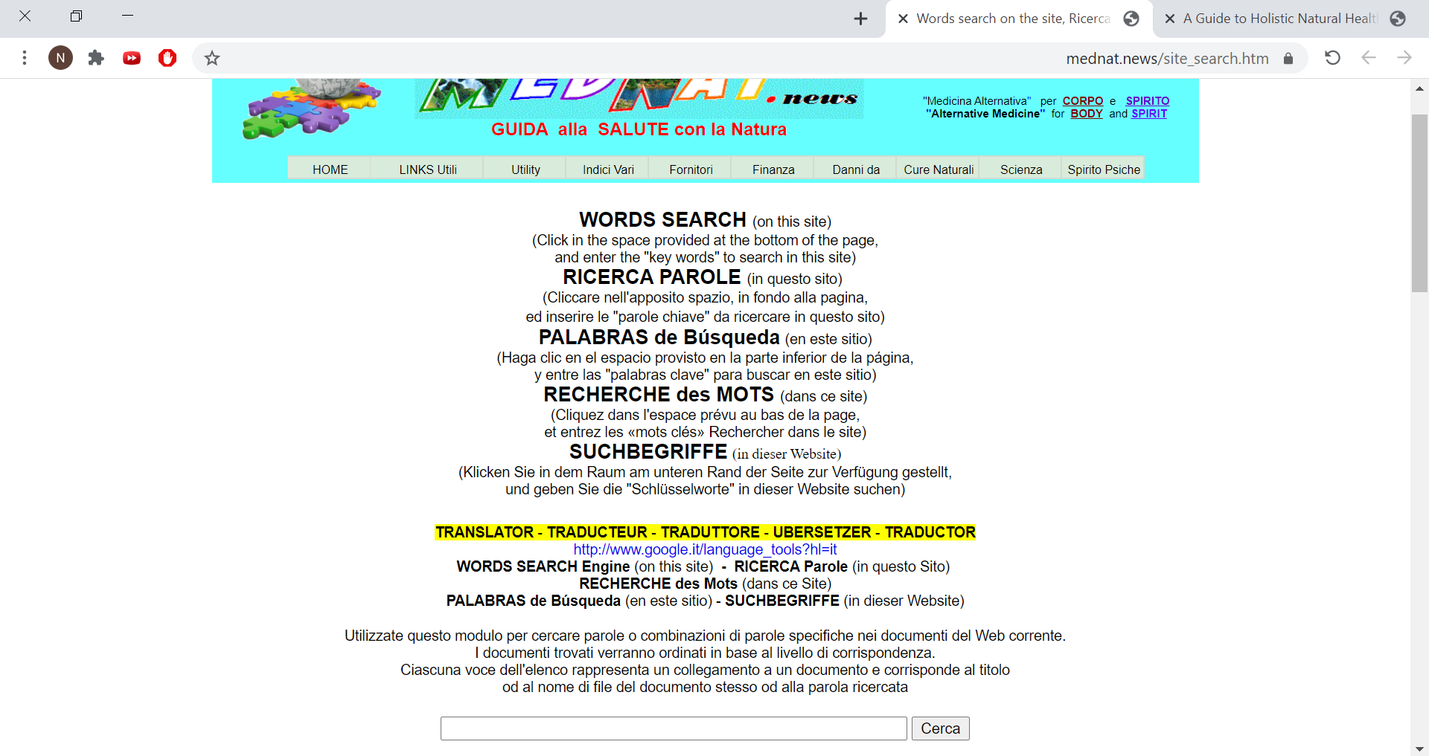

Slide 6
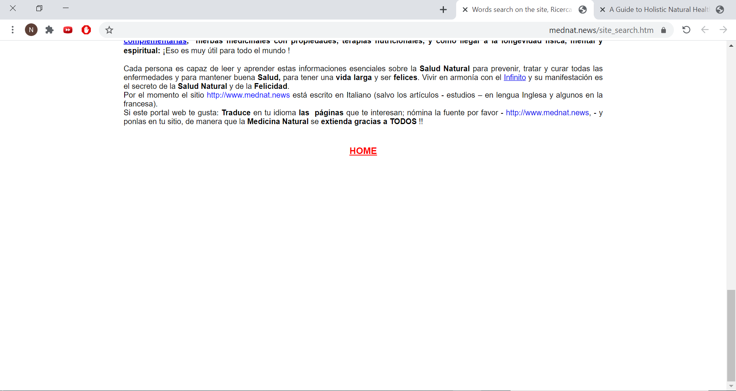
back

Slide 7
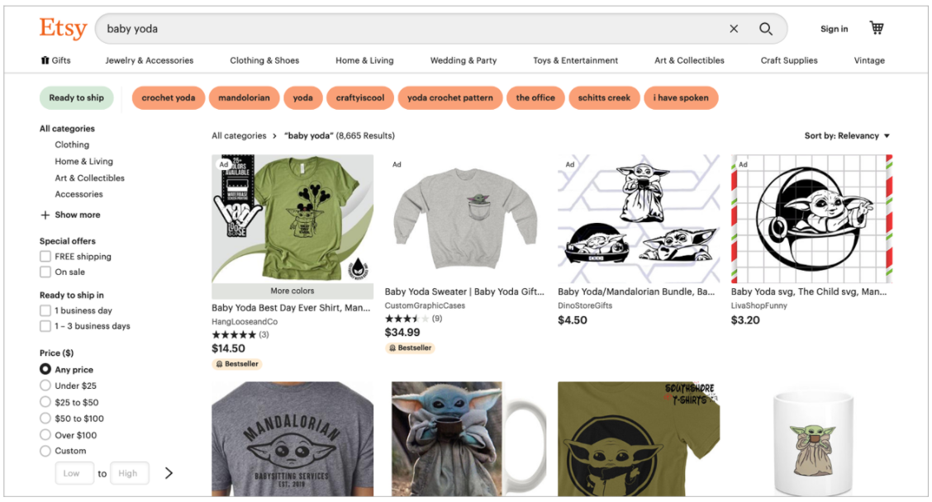
Ecommerce sites like Etsy leverage preexisting mental models to keep customers focused on purchasing products rather than on learning new interaction patterns

Slide 8
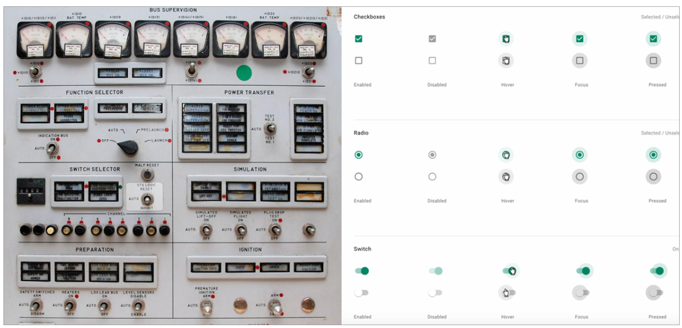
Comparison between control panel elements and typical form elements

Slide 9
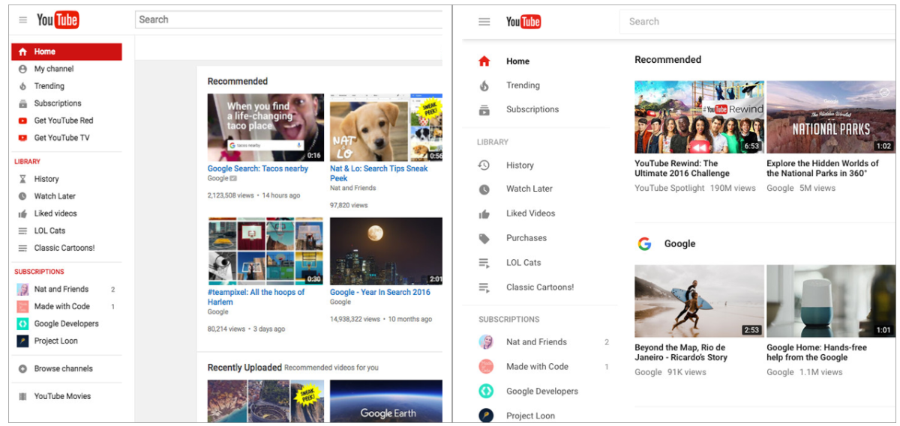
Before (left) and after (right) comparison of YouTube redesign in 2017

